Slide 1
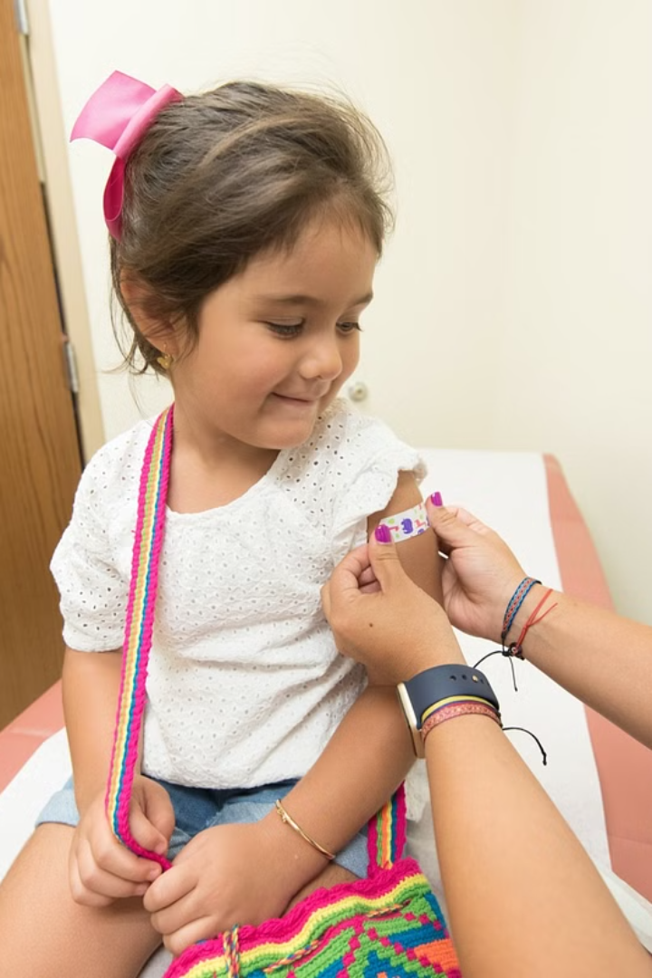
Polio Immunization: A Vital Defense
This presentation explores the critical importance of polio immunization, a crucial public health measure that has saved millions of lives. We will delve into the nature of the polio virus, the effectiveness and safety of vaccines, and the ongoing efforts to eradicate this debilitating disease.

Slide 2
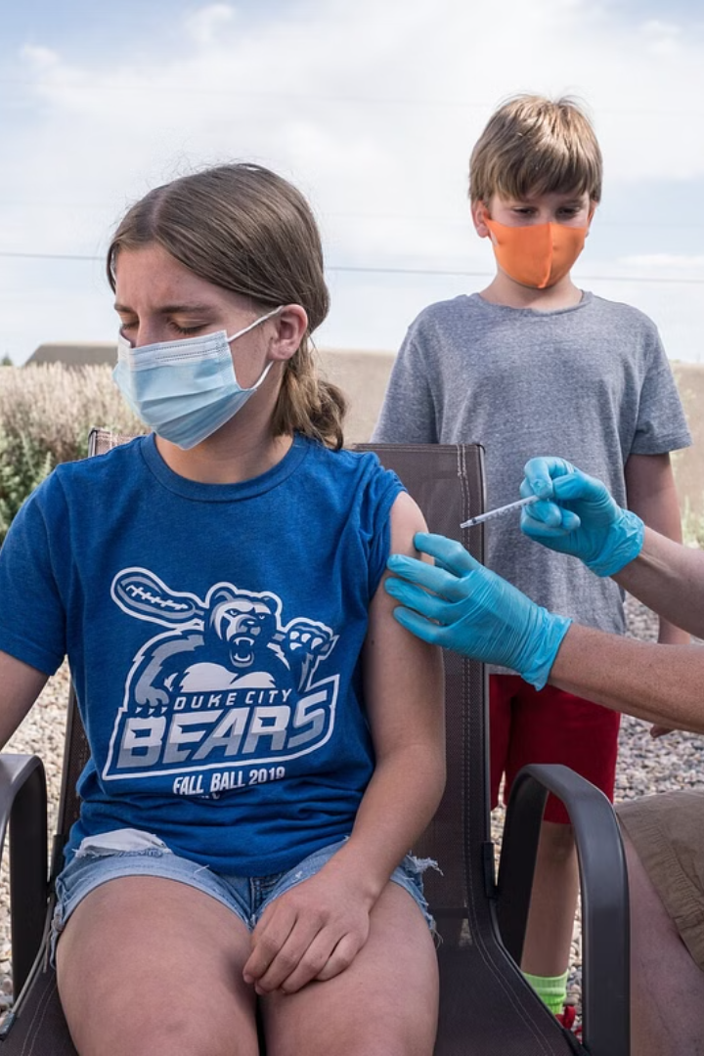

Polio Immunization: A Vital Defense
This presentation explores the critical importance of polio immunization, a crucial public health measure that has saved millions of lives. We will delve into the nature of the polio virus, the effectiveness and safety of vaccines, and the ongoing efforts to eradicate this debilitating disease.

Slide 3
Overview of Polio Virus
A Highly Contagious Virus
Three Types of Polio Virus
Poliovirus is a highly contagious virus that primarily affects young children. It can cause paralysis, breathing difficulties, and even death. The virus spreads through the fecal-oral route, meaning it can be transmitted through contaminated water or food.
There are three types of poliovirus: poliovirus type 1, poliovirus type 2, and poliovirus type 3. Each type is distinct but can cause the same symptoms. While polio type 2 has been eradicated, type 1 and 3 are still a threat.

Slide 4

Importance of Vaccination
1
Preventing Polio Paralysis
2
Protecting Future Generations
Polio vaccination is the most effective way to prevent polio. It has dramatically reduced polio cases worldwide. It is crucial for protecting vulnerable populations, particularly children.
Vaccinations help establish herd immunity, which means a large proportion of the population is immune to the virus. This protects those who cannot be vaccinated due to medical reasons.

Slide 5
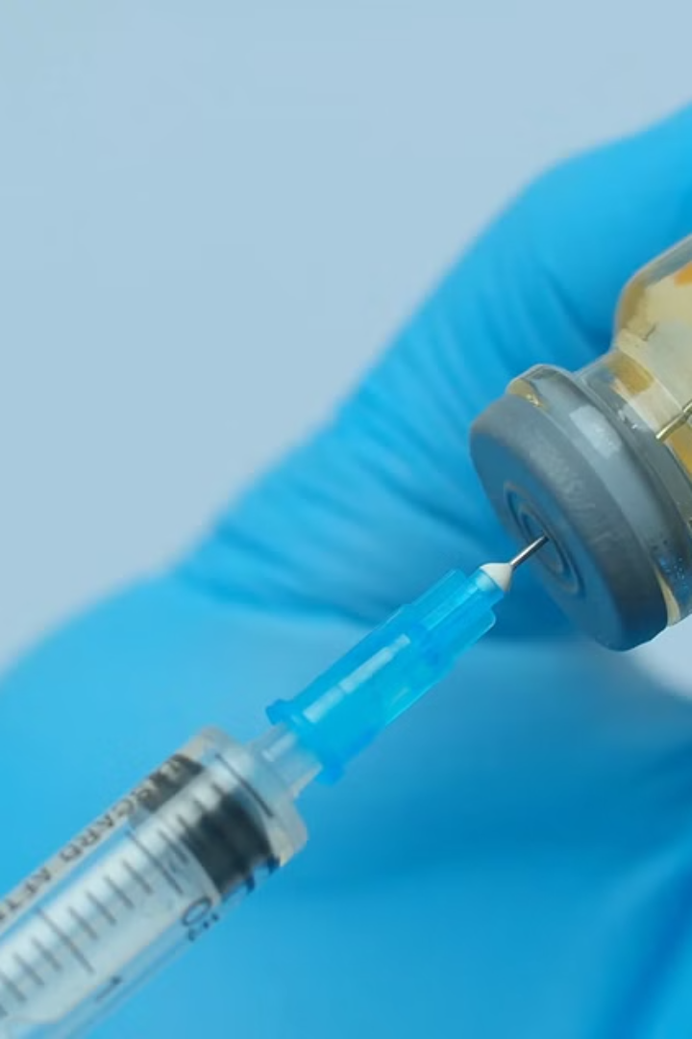
Polio Vaccine Types
Inactivated Poliovirus Vaccine (IPV)
Oral Poliovirus Vaccine (OPV)
IPV is an injection that contains inactivated poliovirus. It is considered very safe and effective. It is administered in a series of shots throughout childhood.
OPV is a liquid vaccine that is given by mouth. It contains live, weakened poliovirus. OPV is highly effective and is used in many countries worldwide.

Slide 6
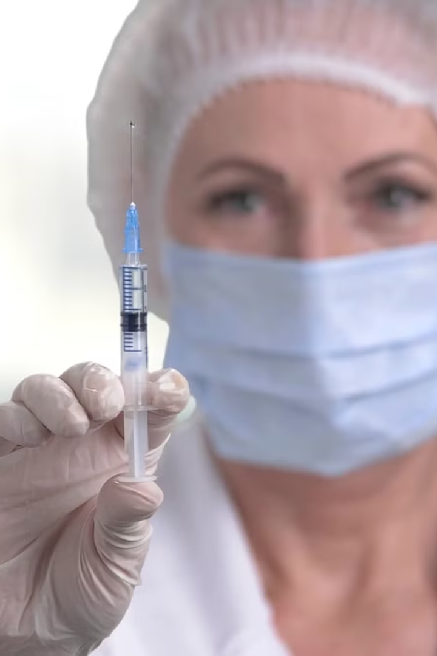


Vaccine Effectiveness and Safety
High Effectiveness
Safe for Children
Polio vaccines are highly effective at preventing polio. They are safe and have been rigorously tested to ensure their efficacy.
Polio vaccines are safe for children and have been administered to millions of people worldwide. Side effects are generally mild and rare.

Slide 7

Annual Day Celebration
A vibrant celebration filled with joy, music, and camaraderie!
Our Annual Day Celebration is a joyous occasion, a testament to the spirit of our vibrant college community.
This year, we are commemorating the spirit of our esteemed institution, showcasing the talents of our students, and celebrating the achievements of our faculty and staff.

Slide 8
Program Agenda
Opening Ceremony
1
Welcome address by the Principal and lighting of the ceremonial lamp.
2
Cultural Performances
A dazzling array of dance, music, and drama, showcasing the artistic talents of our students.
Guest Speaker
3
An inspirational talk by a renowned personality, sharing valuable insights and motivating students.
4
Award Ceremony
Recognizing the academic and extracurricular achievements of our students.
Dinner & Entertainment
5
A delightful dinner followed by a mesmerizing entertainment program.

Slide 9
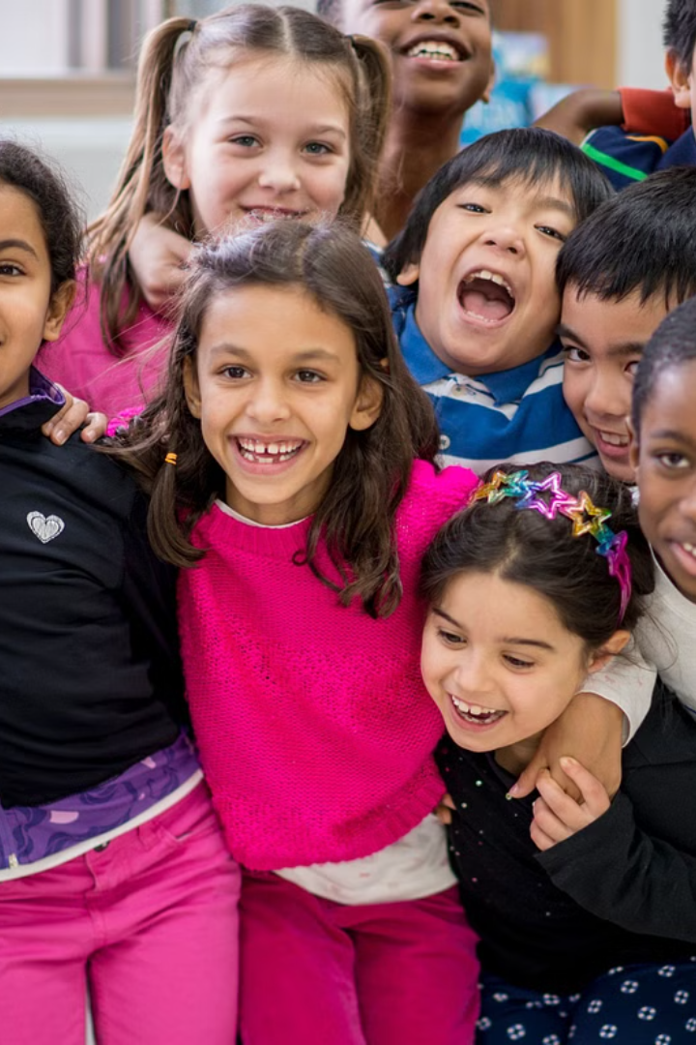
Thank You
We appreciate your time and attention. We hope this presentation has provided valuable insights into polio immunization and its importance.
Let's work together to protect future generations from this devastating disease.

